Slide 1
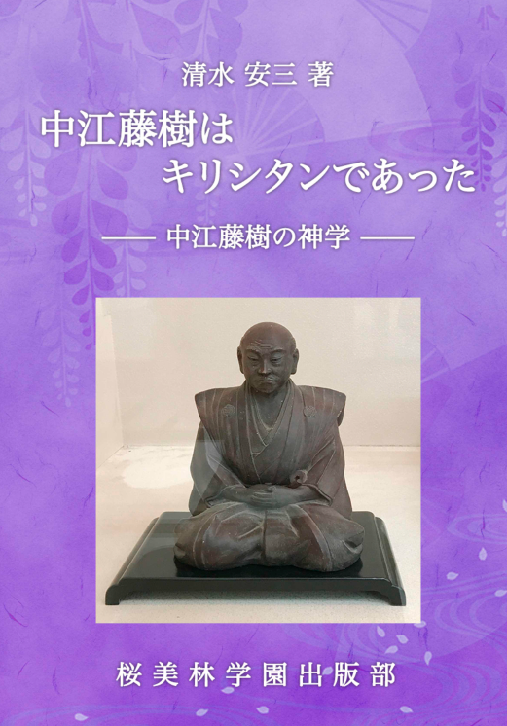
"On Working on a Modern Translation”
Koji Sato
Given the opportunity to create a modern Japanese translation
of five books by an author born
in the Meiji era.
2025/06/12

Slide 2
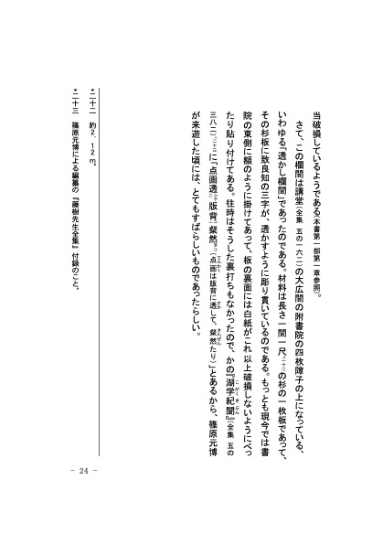
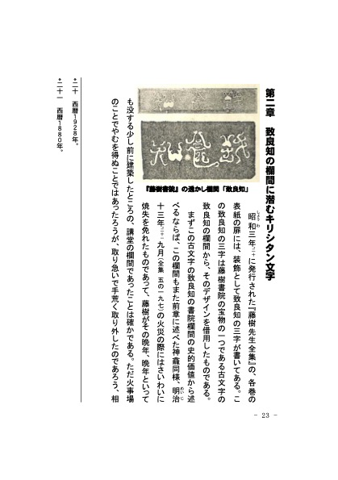
"Nakae Tōju was a Christian" by Yasuzō Shimizu
Translated into a modern writing style that even today's young students can understand.
Thoroughly researched literature and historical materials to verify the main text and its annotations.
The manuscript text was version-controlled using GitHub.
Tōju is a confucian scholar in Japanese EDO era

Slide 3
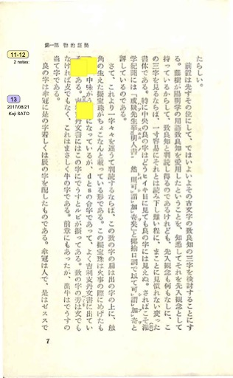
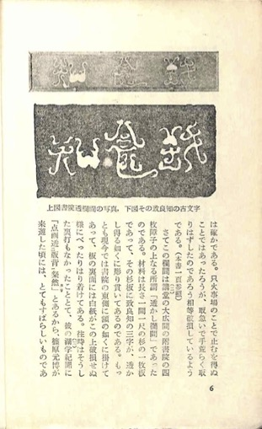
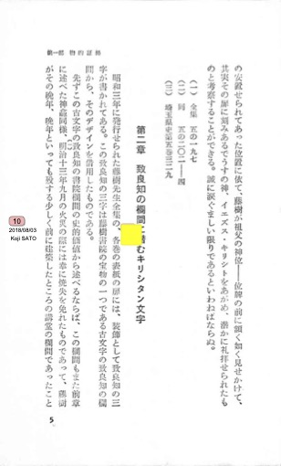
Original Texts were Thoroughly Scanned and Marked-up.

Slide 4
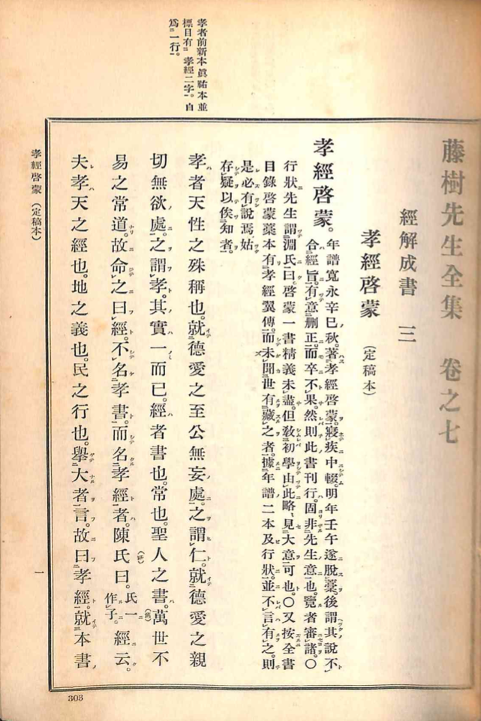
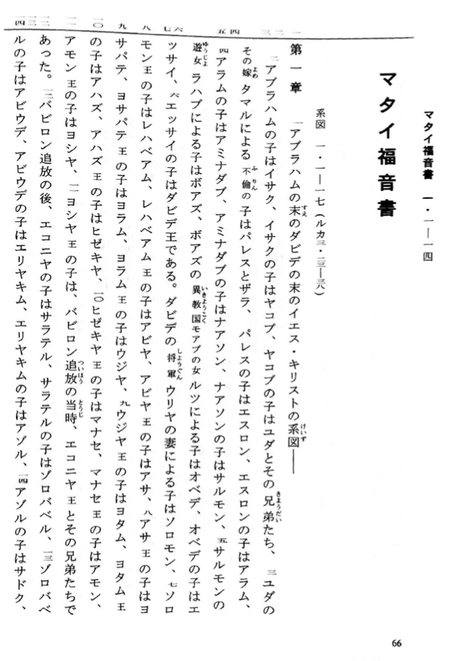
Reference Materials were also Thoroughly Scanned and Marked-up.
Reference materials ranged from the Edo era to the Showa era.
Numerous references to Kanbun (classical Chinese) and Kobun (classical Japanese) texts.
Numerous citations from the Bible.

Slide 5
The original author was the founder of a private university who was born in the Meiji era and lived into the Showa era.
A total of 659 reference materials were scanned into PDFs, amounting to approximately 7.11 GB of files.
Although I had been away from classical Japanese and Chinese since high school, I engaged with them thoroughly and became able to read and write them again.

Slide 6
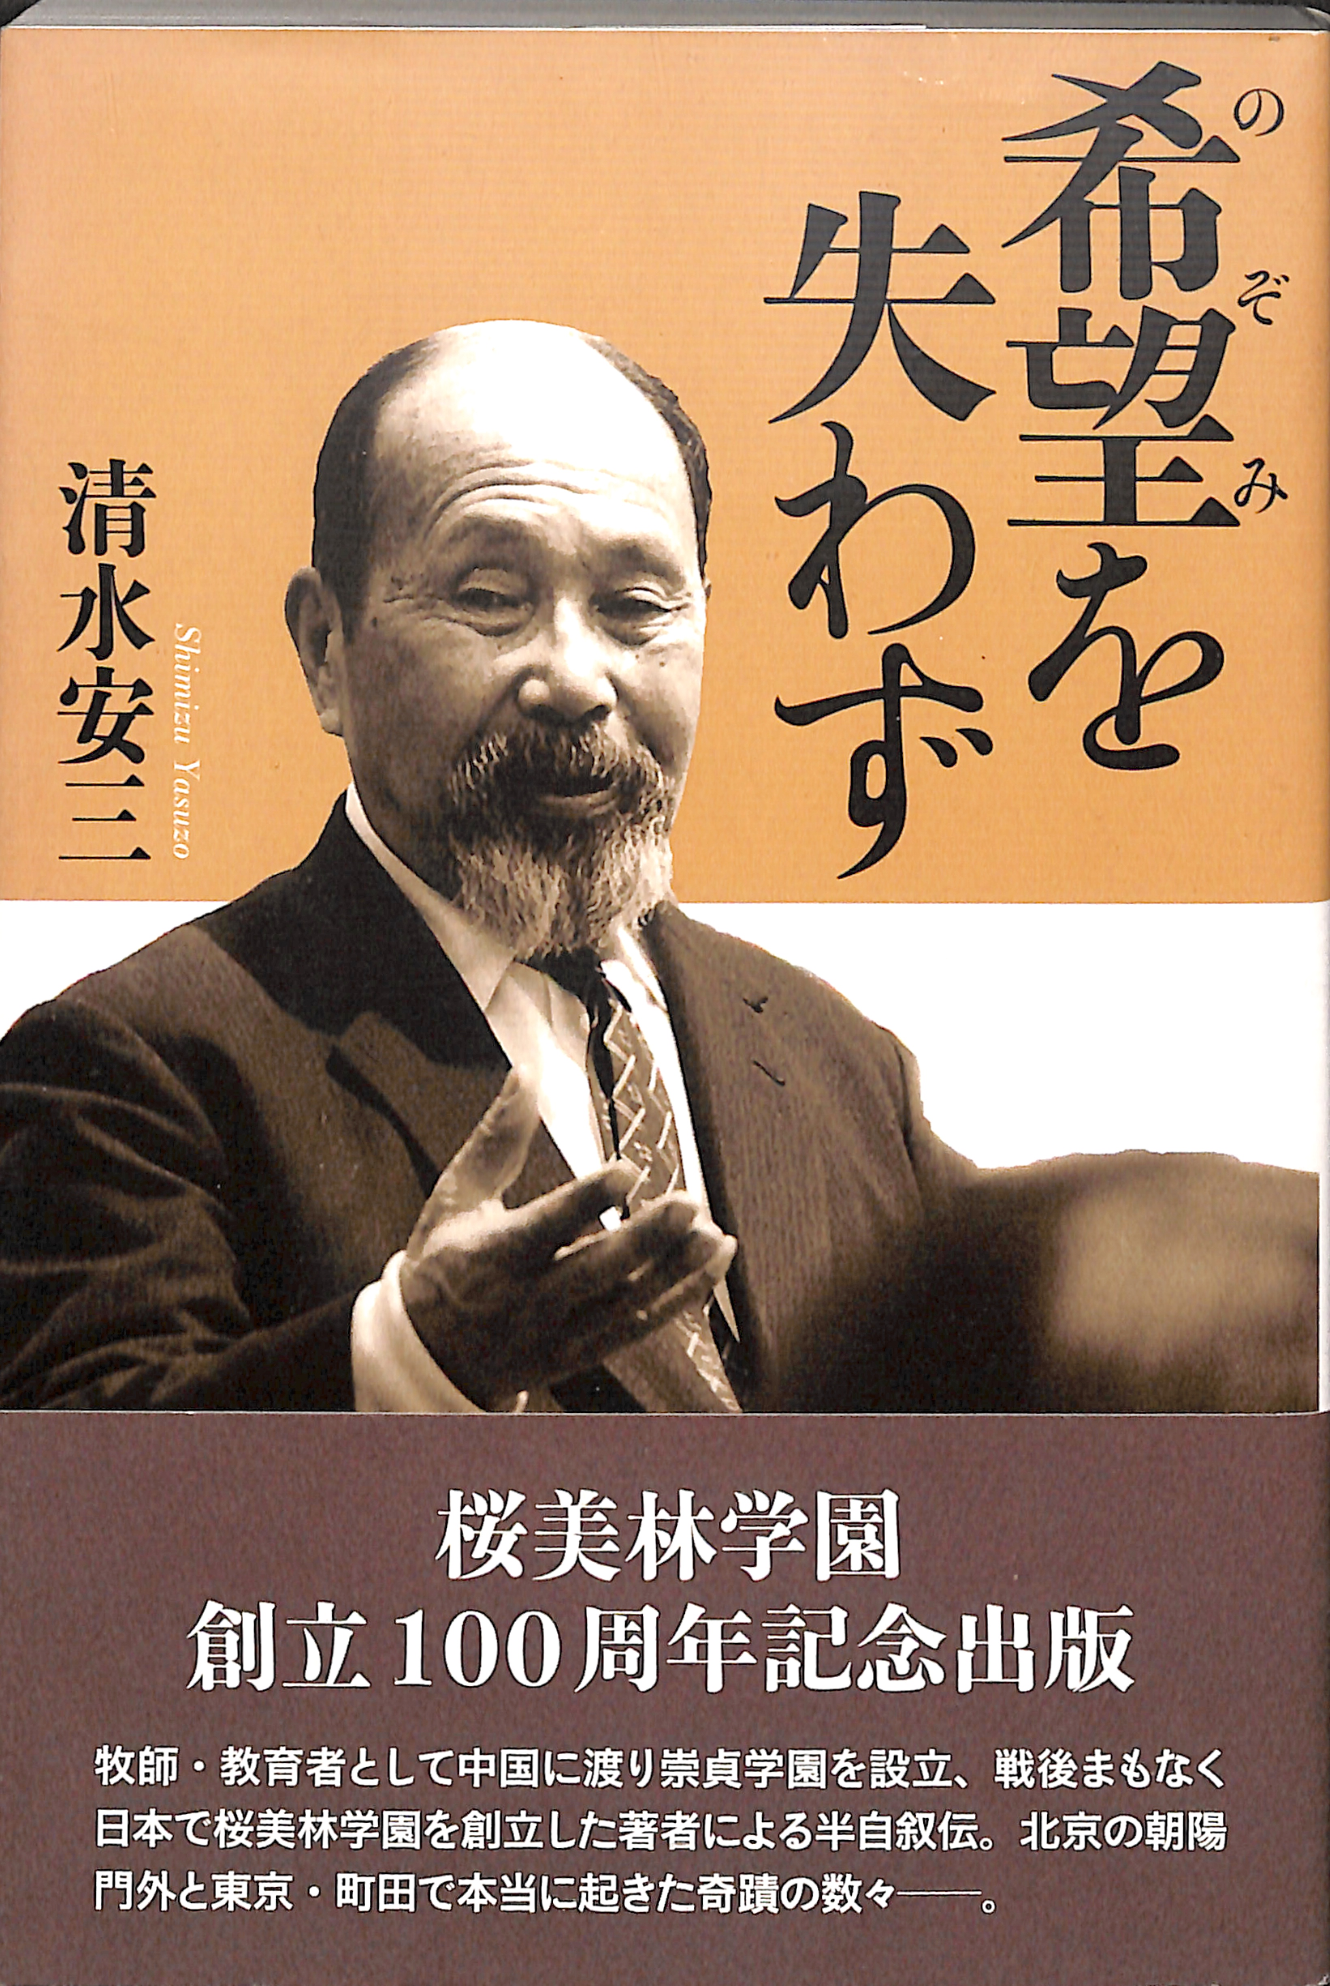
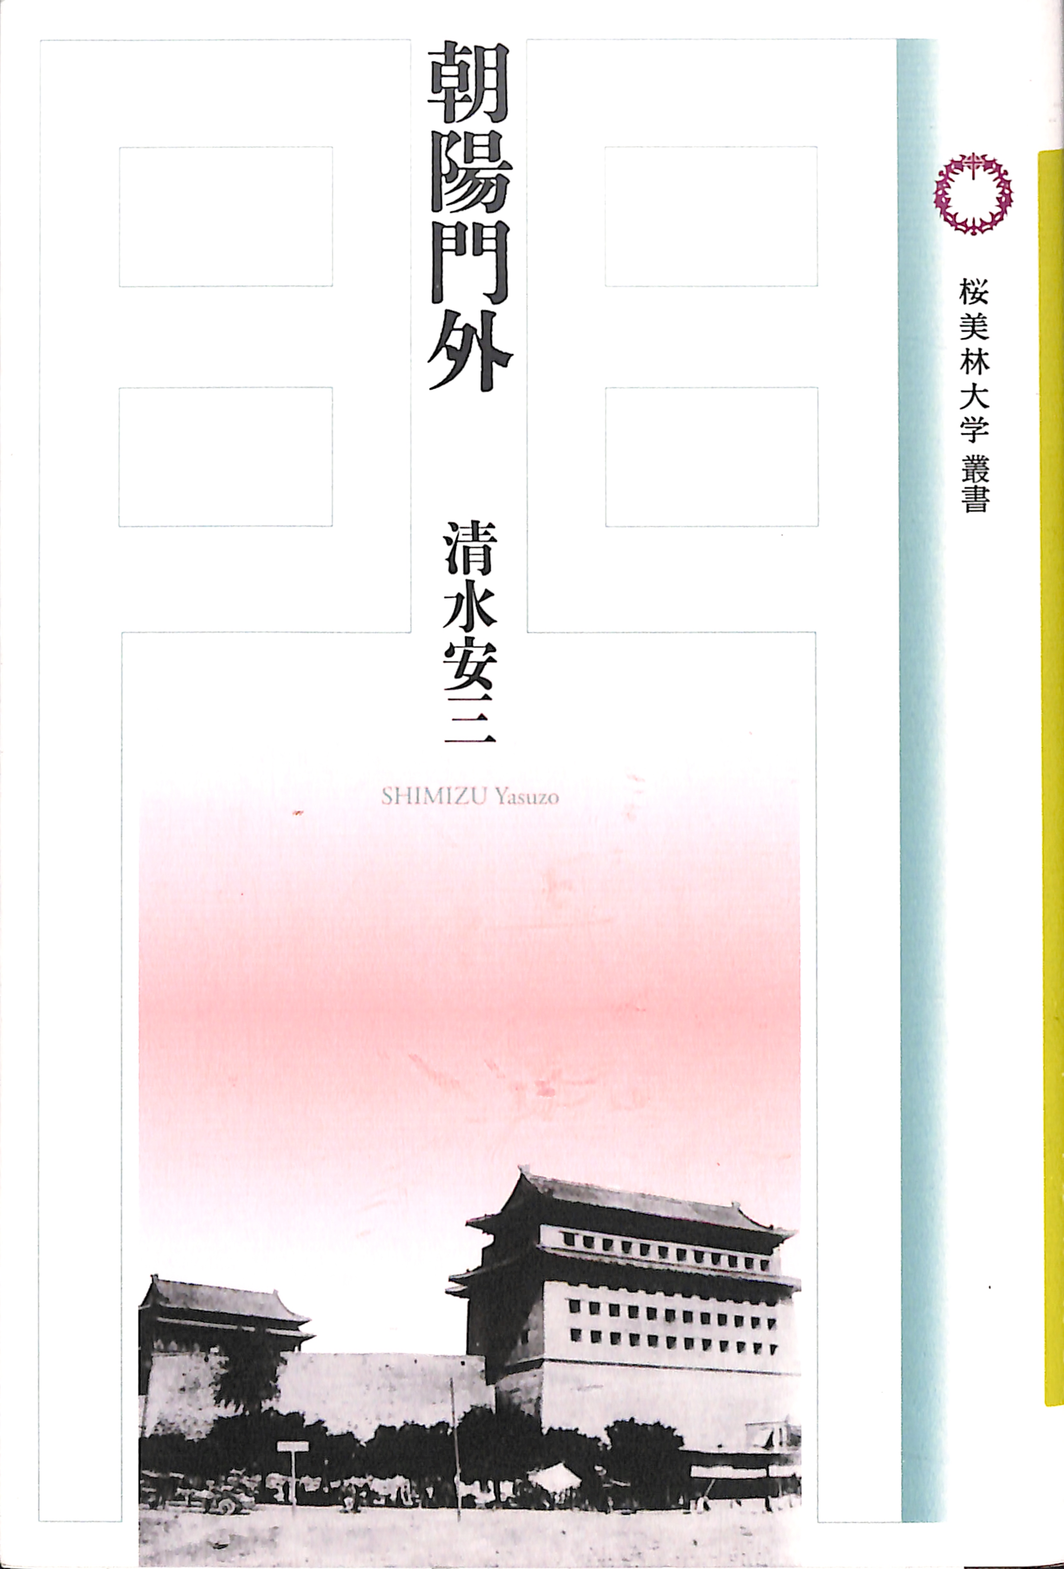
Two books have already been published
(with manuscripts for the remaining three delivered).

